Slide 1
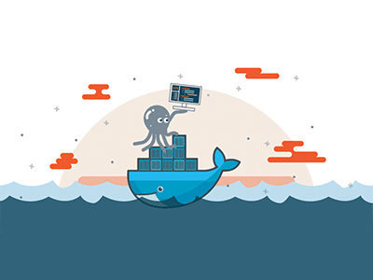

Introduction to docker

Slide 2
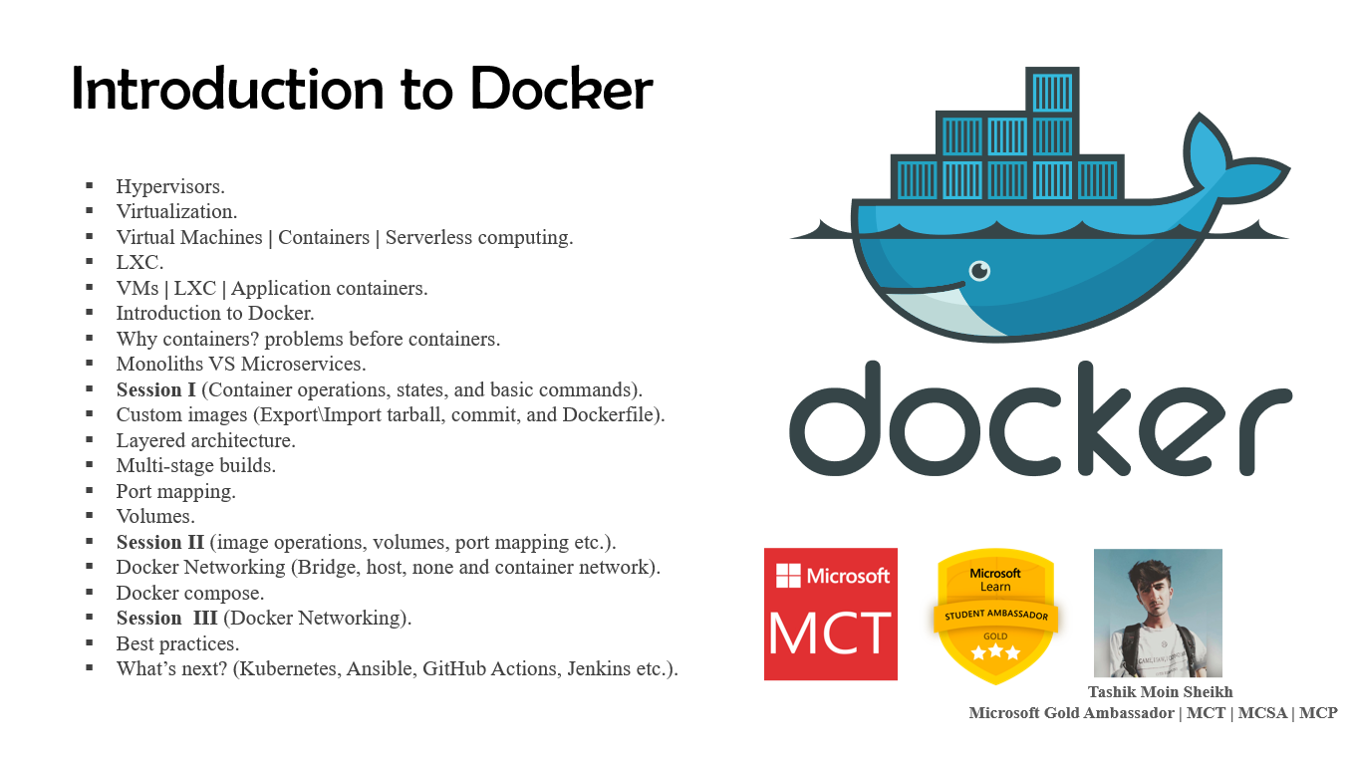

Slide 3
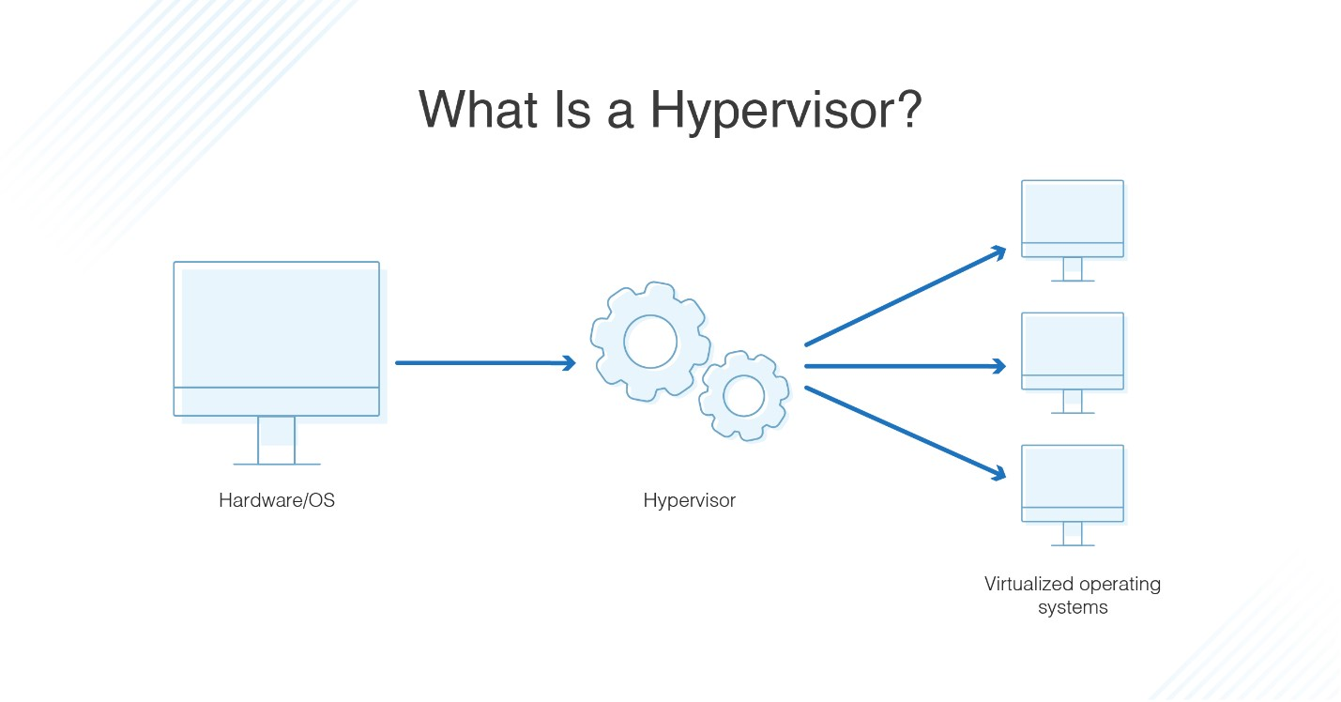

Hypervisor
A hypervisor, also known as a virtual machine monitor or VMM, is software that creates and runs virtual machines (VMs). A hypervisor allows one host computer to support multiple guest VMs by virtually sharing its resources, such as memory and processing.

Slide 4
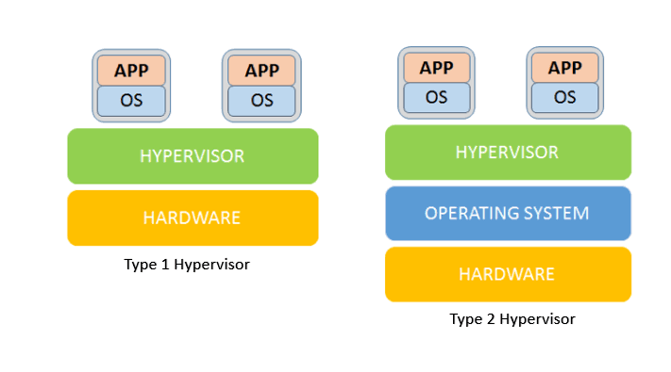
Bare metal (Type 1) vs hosted (type 2)
ESXi, Hyper-V, and Apple Boot Camp etc.
MSFT Virtual PC, Virtual Box, VMware Workstation etc.

Slide 5
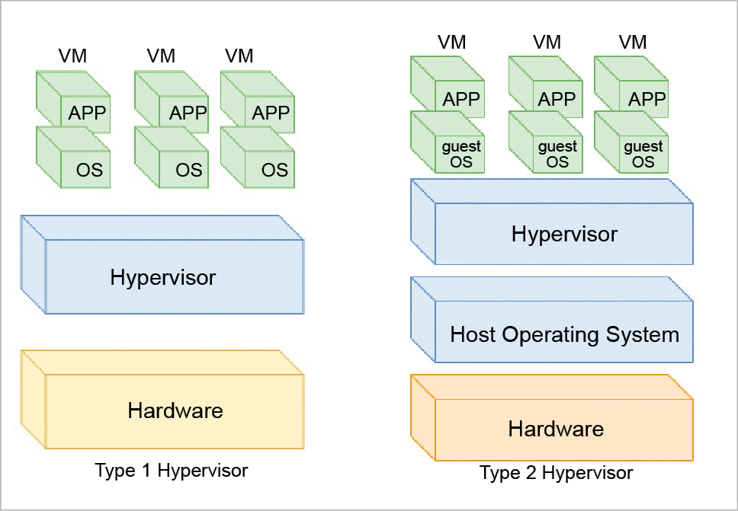
“OS” (No Host OS)
“Guest OS”

Slide 6
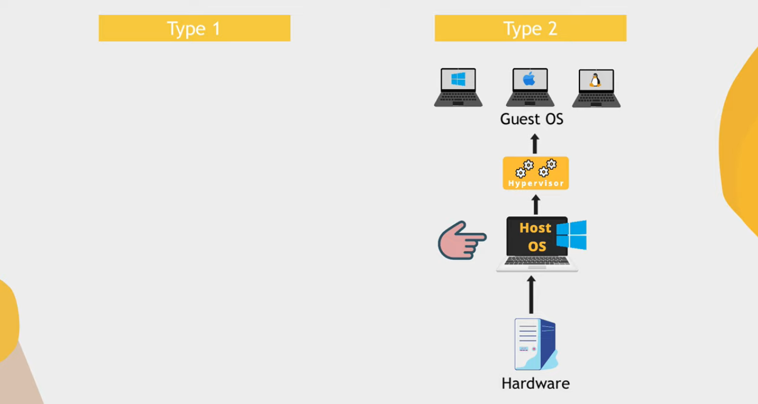

Slide 7
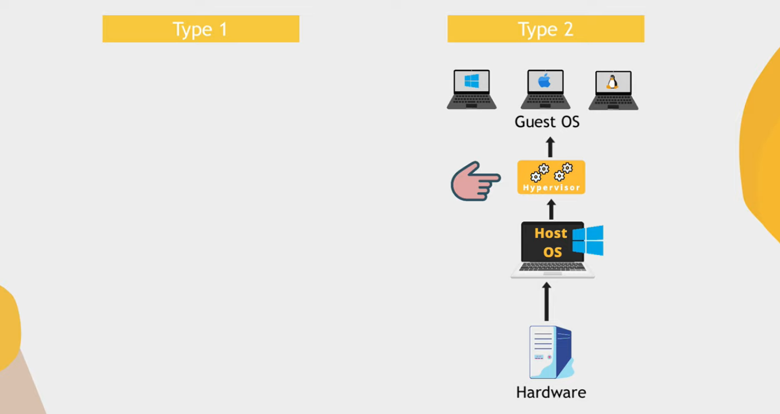

Slide 8
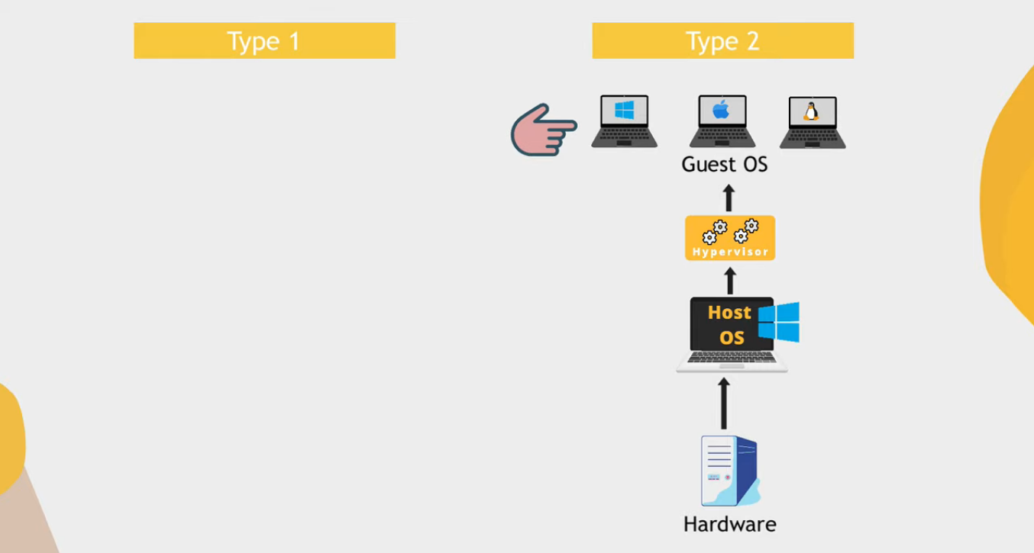

Slide 9
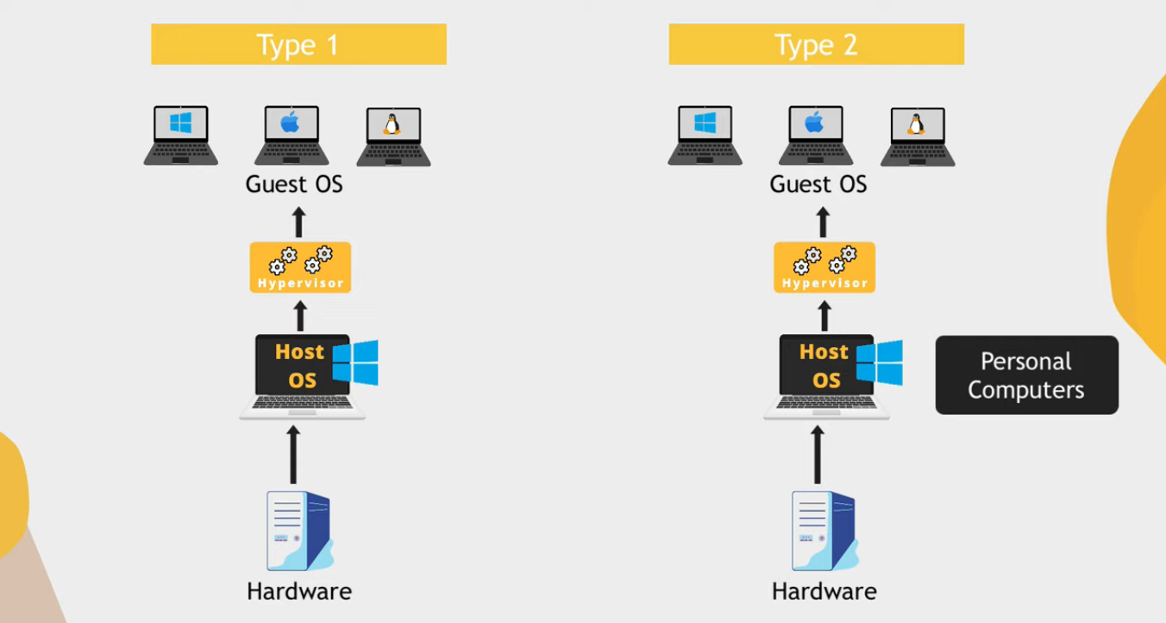
“Can only allocate host OS resources for virtualization”
“Same hardware resources”

Slide 10
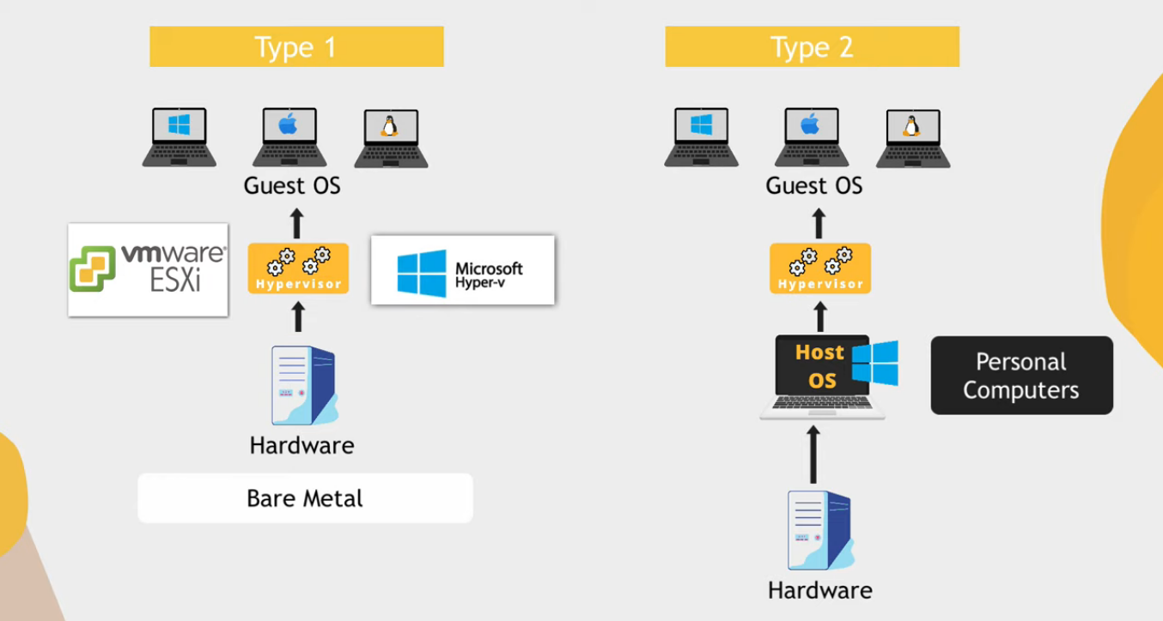

Slide 11
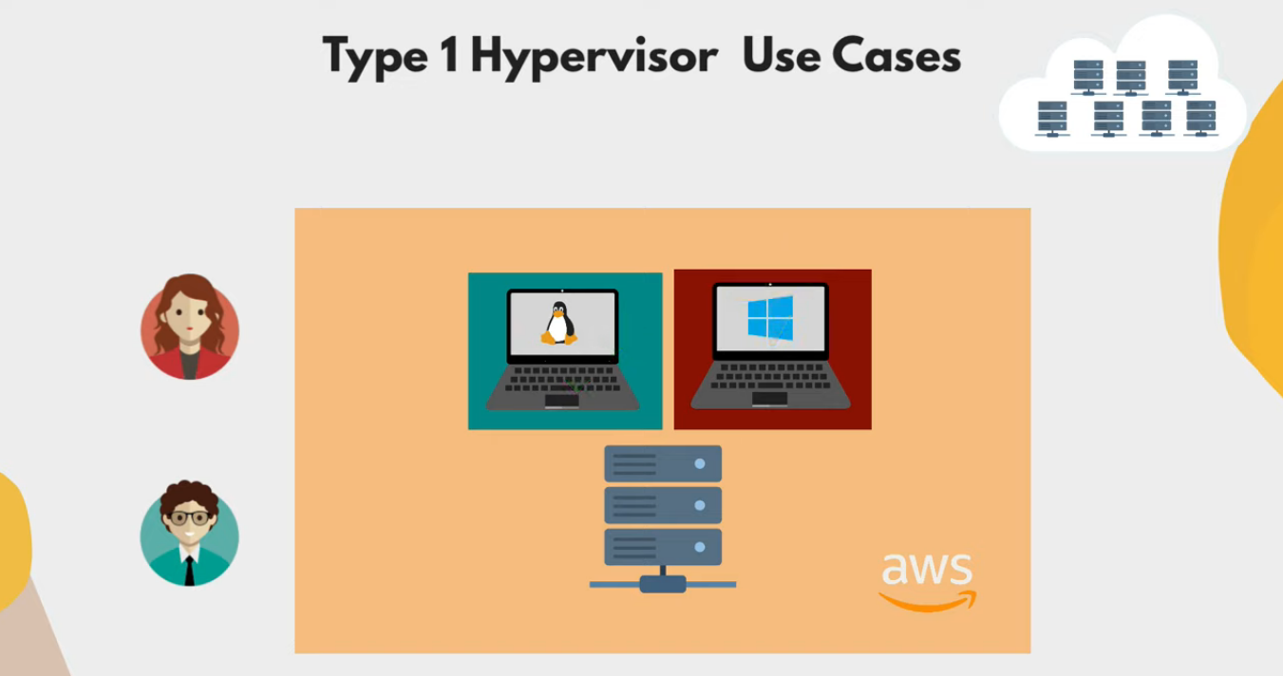

Slide 12
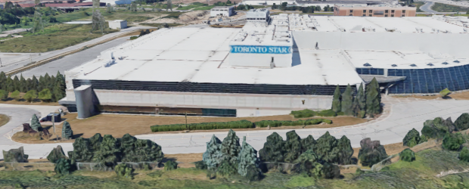
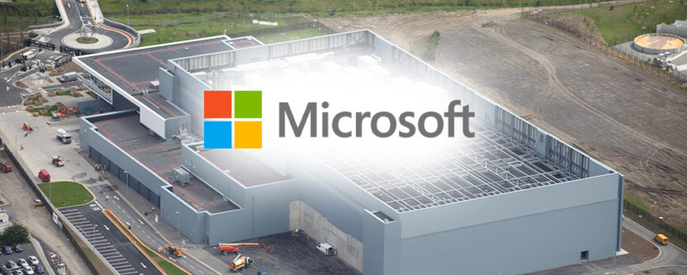
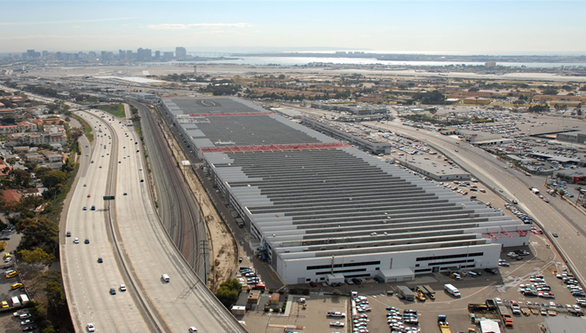
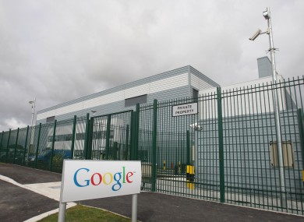
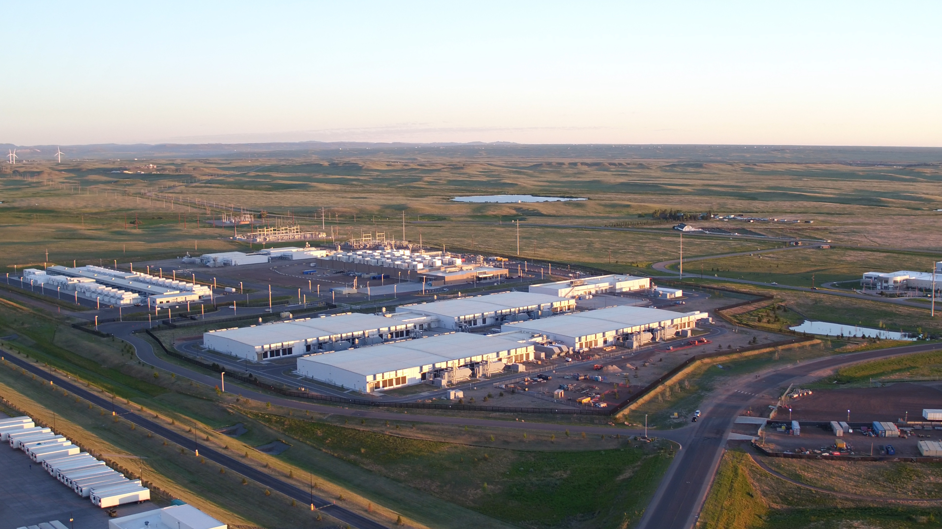
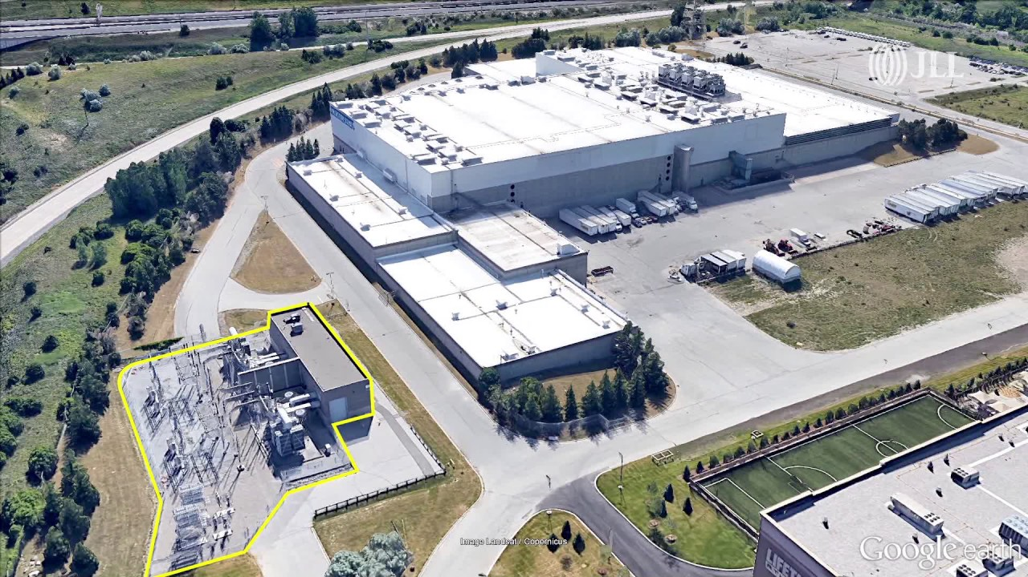

Slide 13
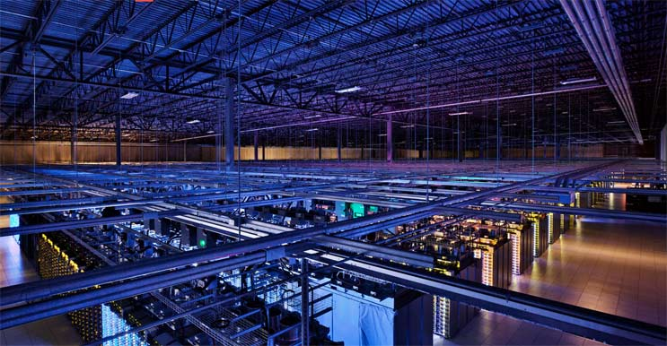
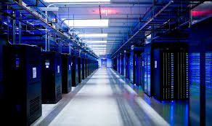
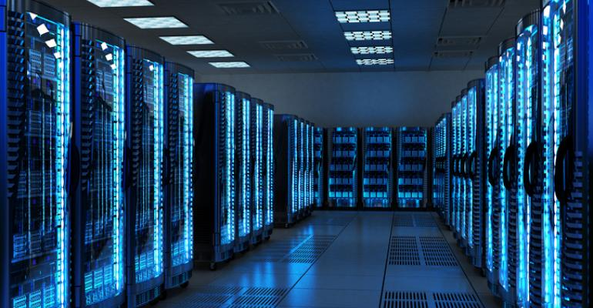
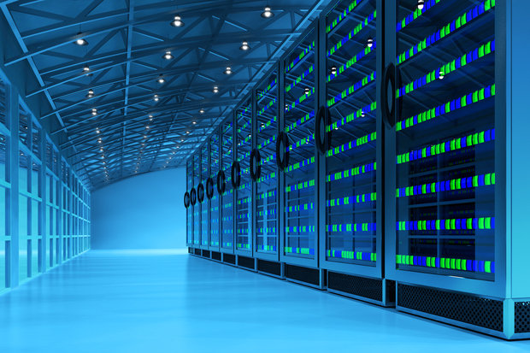

Slide 14
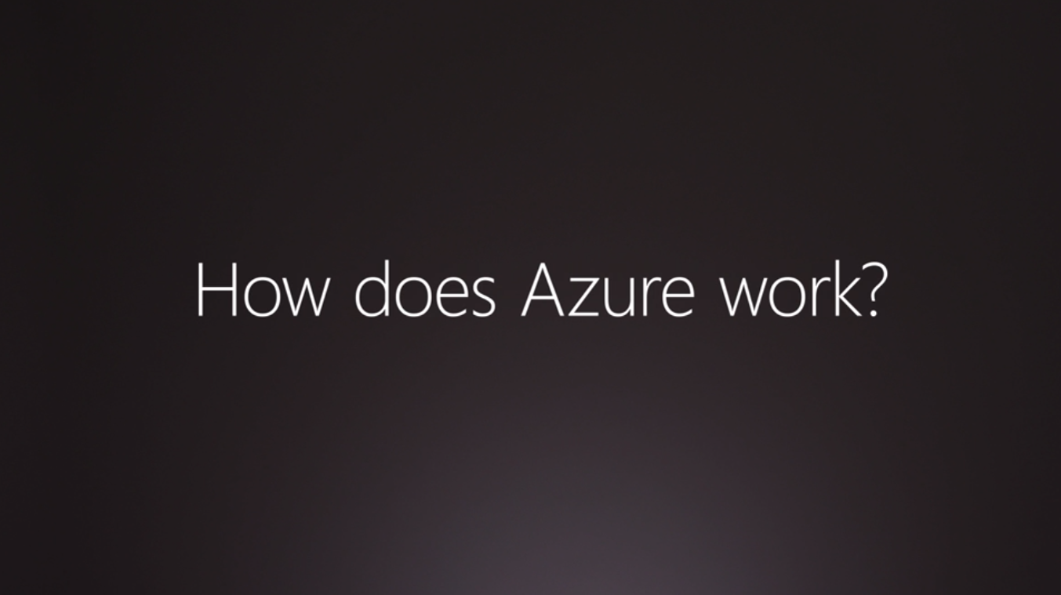

Slide 15
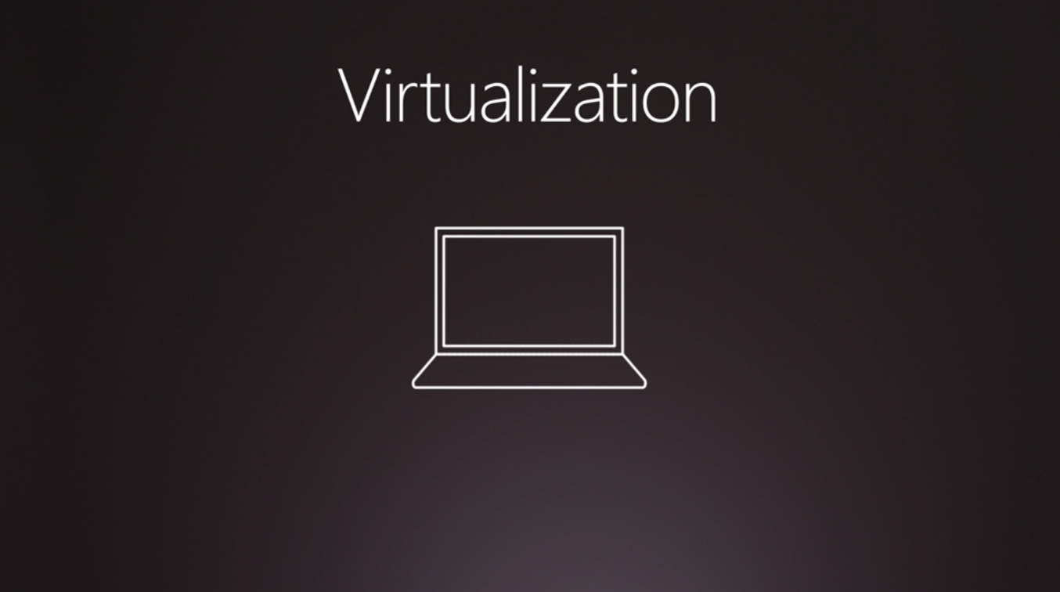

Slide 16
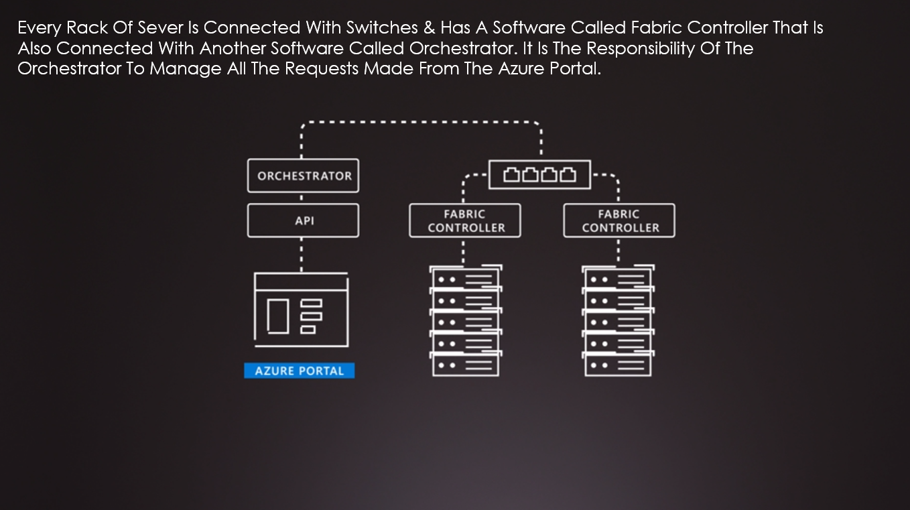

Slide 17
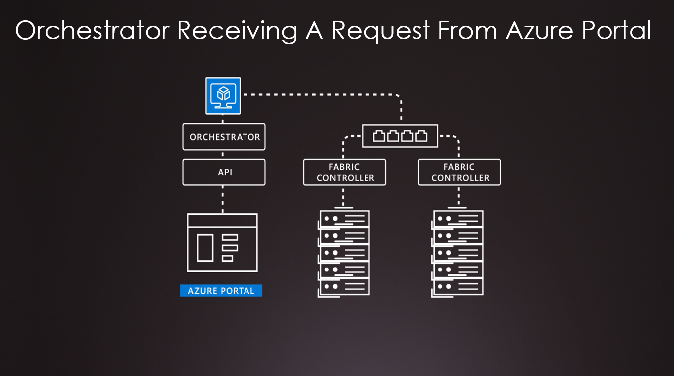

Slide 18
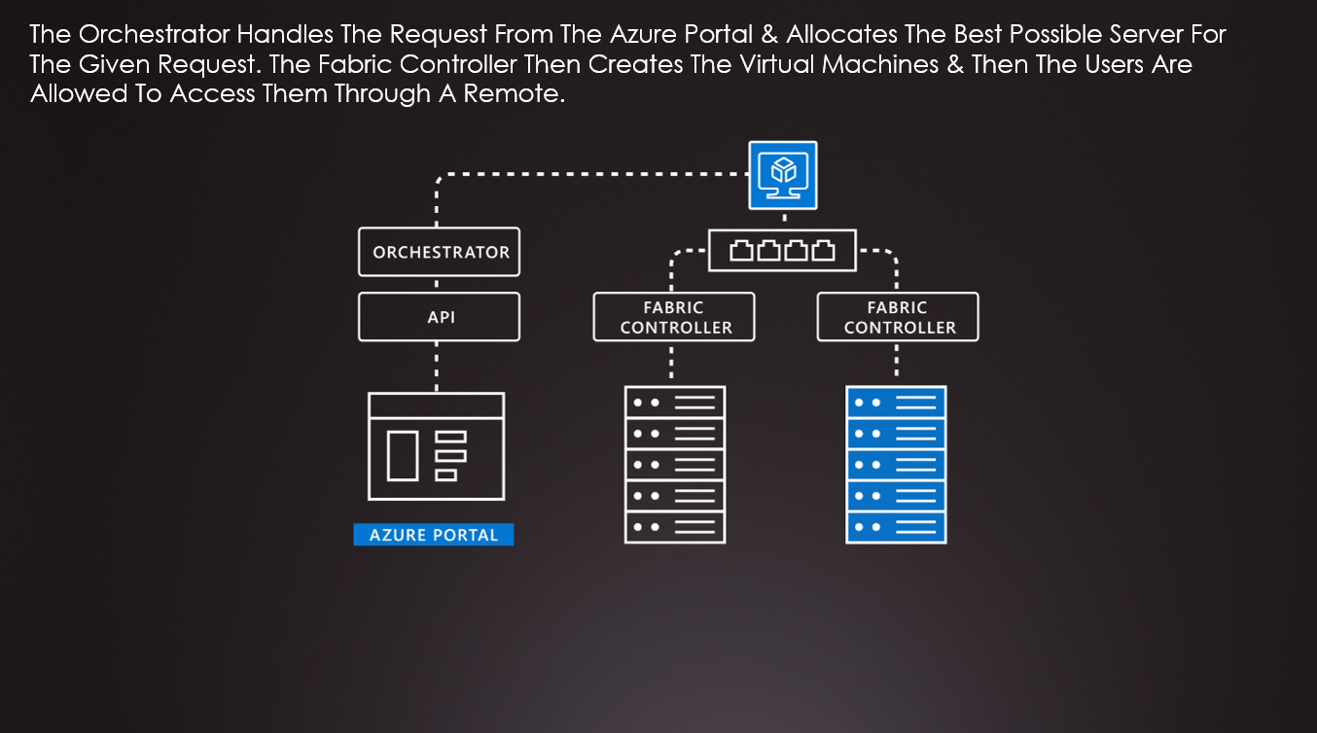

Slide 19
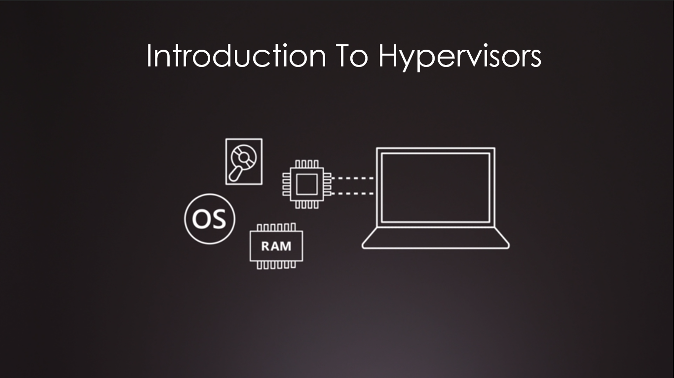

Slide 20
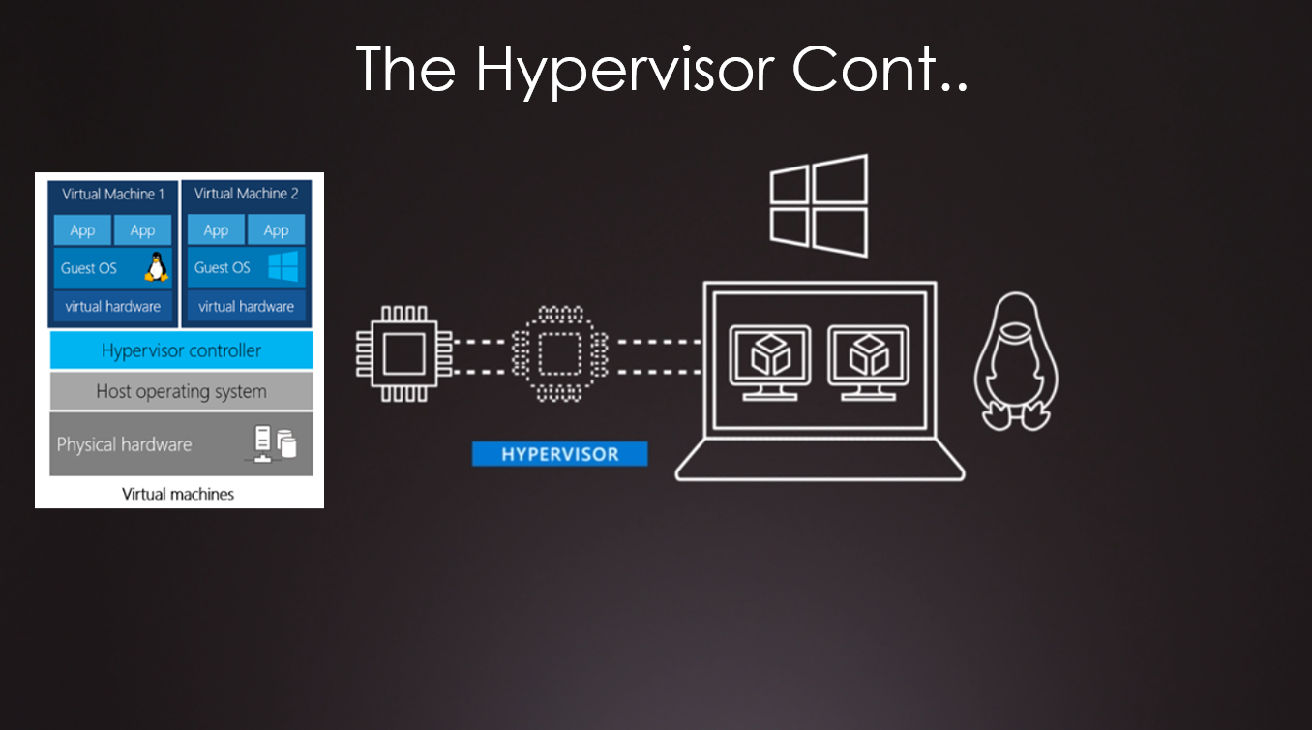

Slide 21
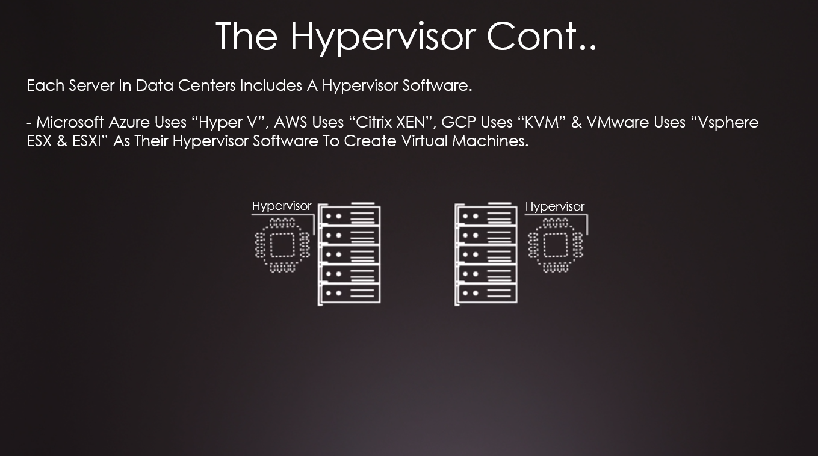

Slide 22
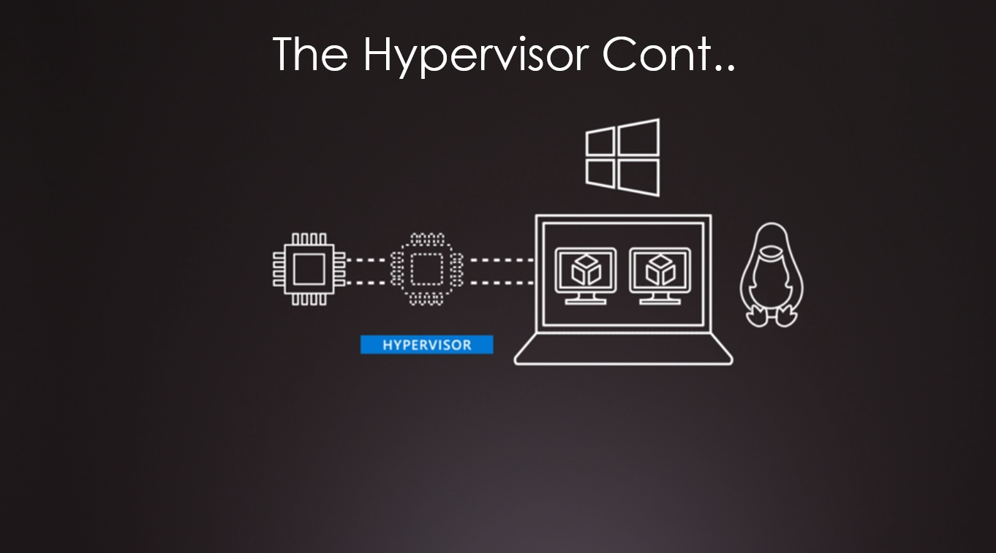

Slide 23
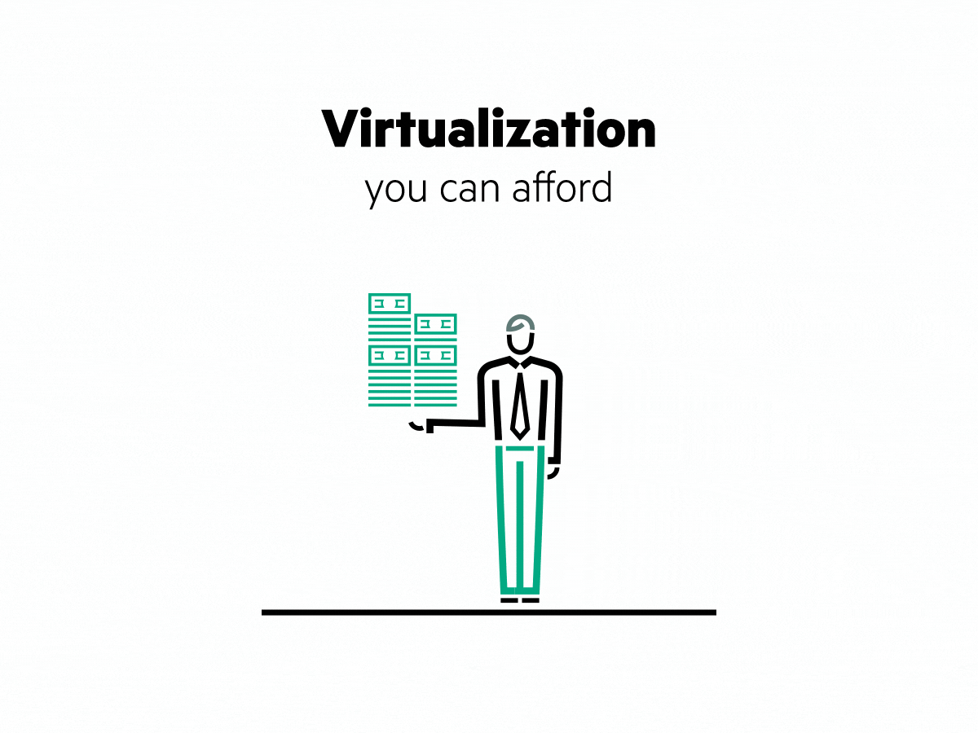
virtualization
Virtualization is the process of running a virtual instance of a computer system in a layer abstracted from the actual hardware. Most commonly, it refers to running multiple operating systems on a computer system simultaneously. Virtualization is the creation of a virtual -- rather than actual -- version of something, such as an operating system (OS), a server, a storage device or network resources. Virtualization uses software that simulates hardware functionality in order to create a virtual system Virtualization refers to the creation of a virtual resource such as a server, desktop, operating system, file, storage or network. The main goal of virtualization is to manage workloads by radically transforming traditional computing to make it more scalable.

Slide 24
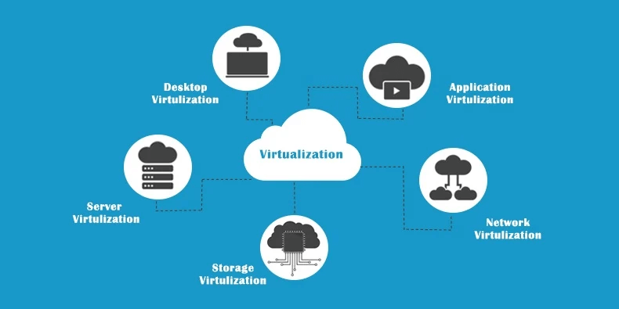

Slide 25
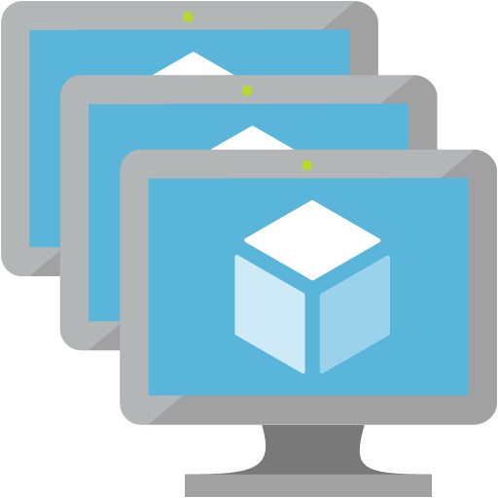
Virtual machines
Definition
Virtual machines are software computers that provide the same functionality as physical computers. Like physical computers, they run applications and an operating system. However, virtual machines are computer files that run on a physical computer and behave like a physical computer. In other words, virtual machines behave as separate computer systems.
Types Of Virtual Machines Process Virtual Machines Execute computer programs in a platform-independent environment. It masks the information of the underlying hardware or operating system. This allows the program to be executed in the same fashion on any platform. Example : JVM, .NET Core CLR etc.
System Virtual Machines
Support the sharing of a host computer’s physical resources between multiple virtual machines.
Example : Virtual Machines Created From VMware.

Slide 26
The JVM is called a virtual machine because the JVM definition defines an abstract machine. This includes registers, stack, etc., and the byte code that Java source is compiled to is practically machine code for this virtual machine. The JVM then interprets or compiles this byte code into native machine instructions.

Slide 27
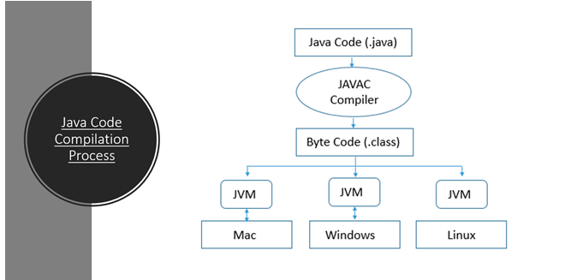

Slide 28
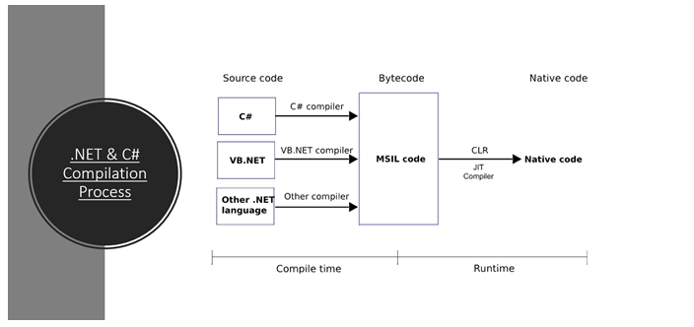

Slide 29
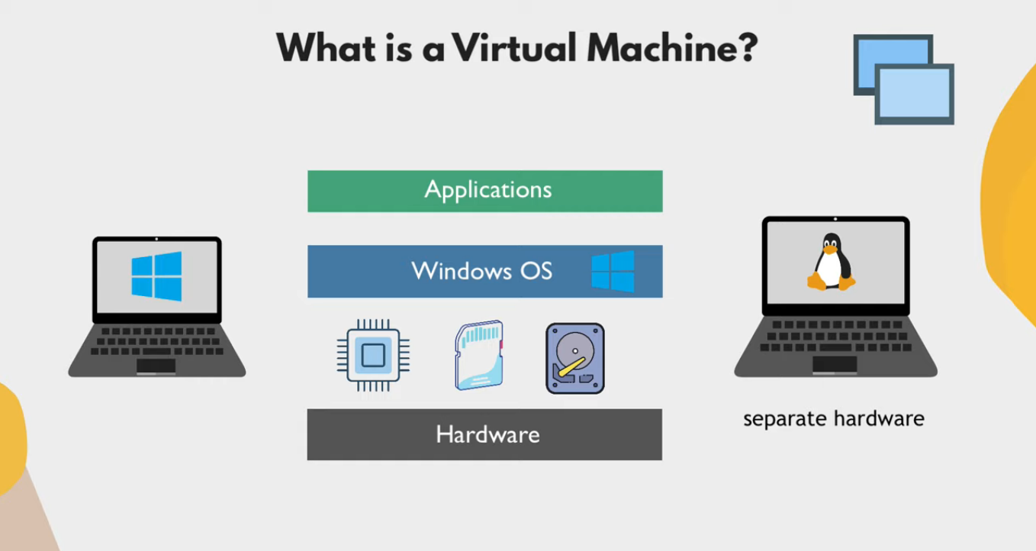

Slide 30
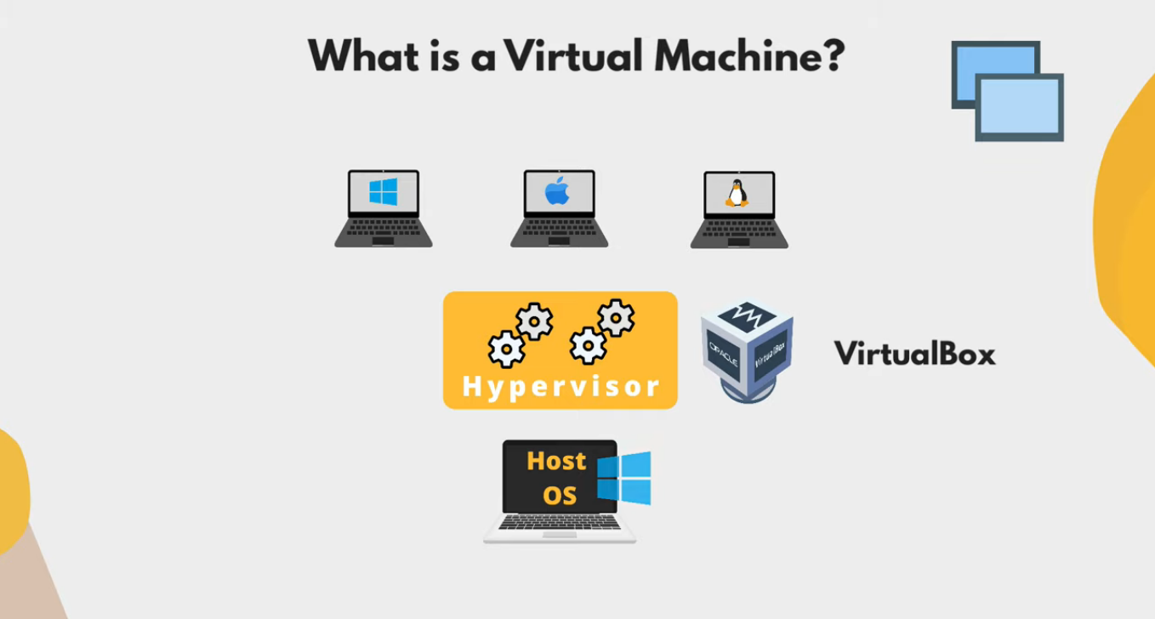

Slide 31
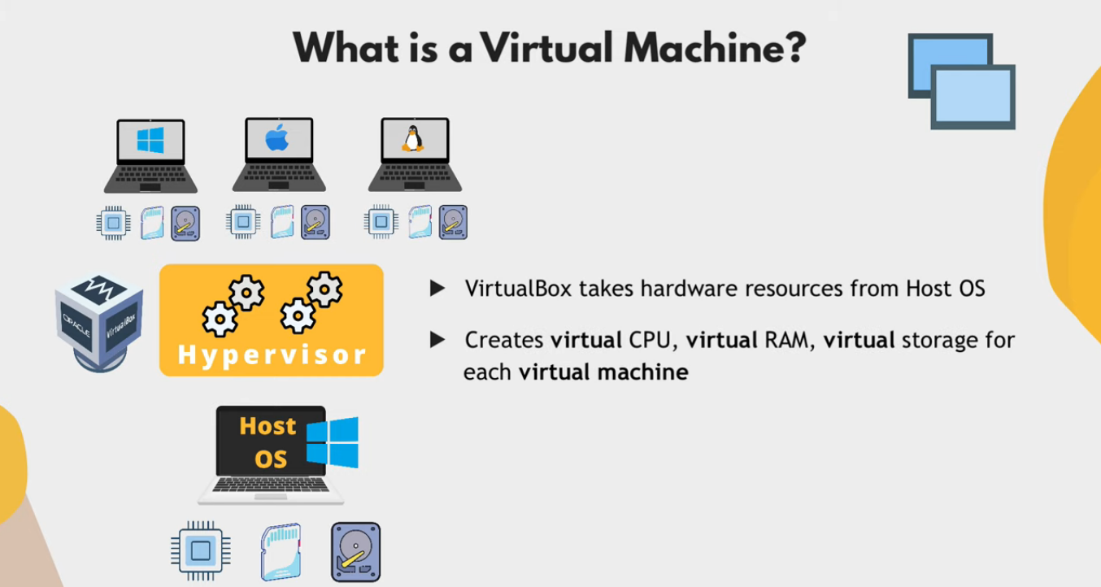

Slide 32
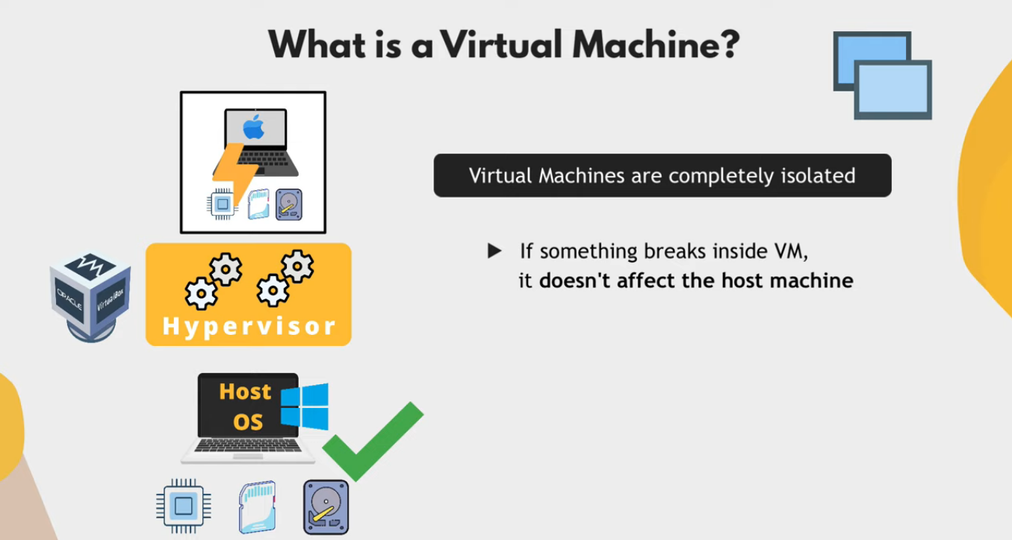

Slide 33
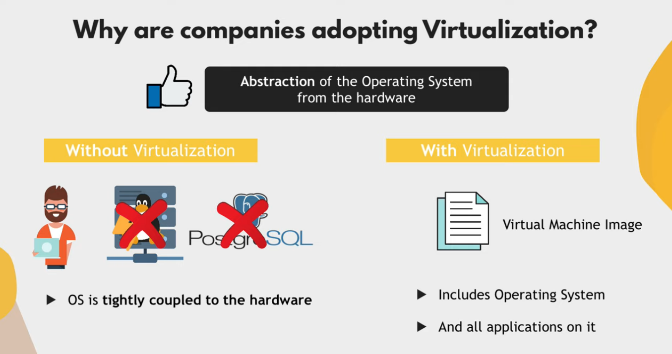

Slide 34
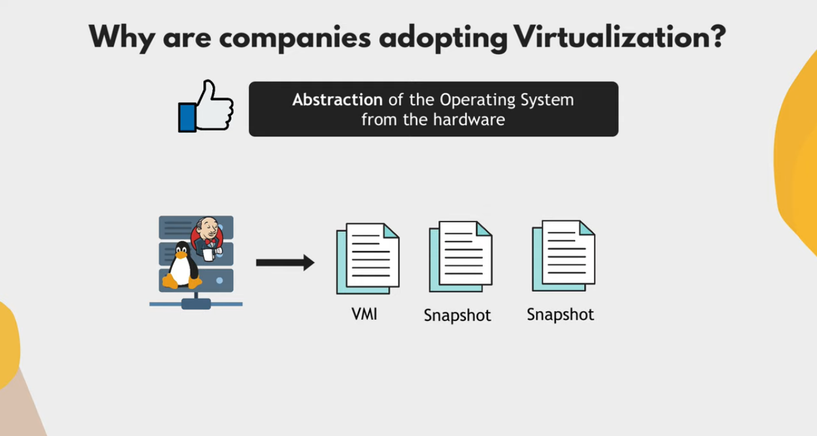

Slide 35
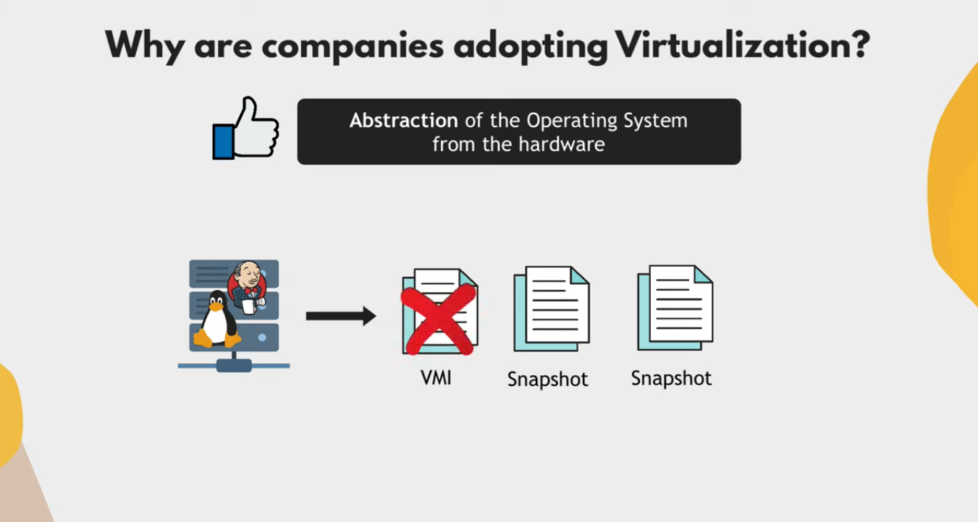
“Snapshot X”
Linux operating system represents everything in a file system, the hardware devices that we attach are also represented as a file. The terminal is also represented as a file.
“Time 0”
“Time 1”
“Time N”

Slide 36
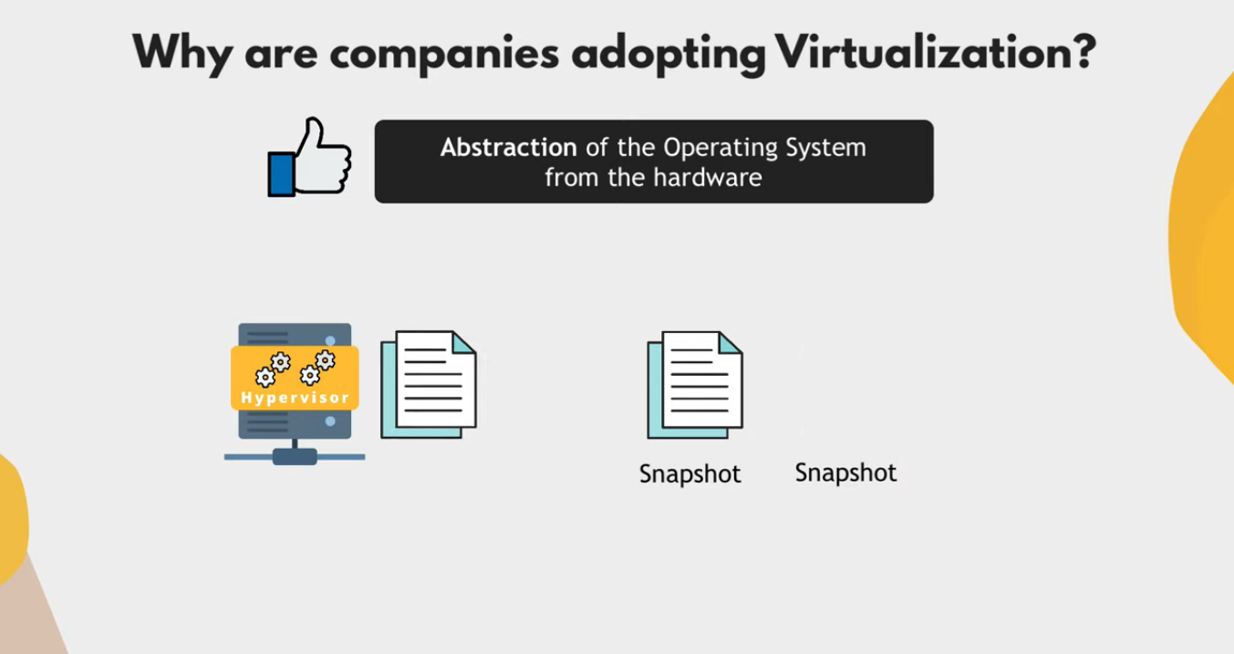

Slide 37
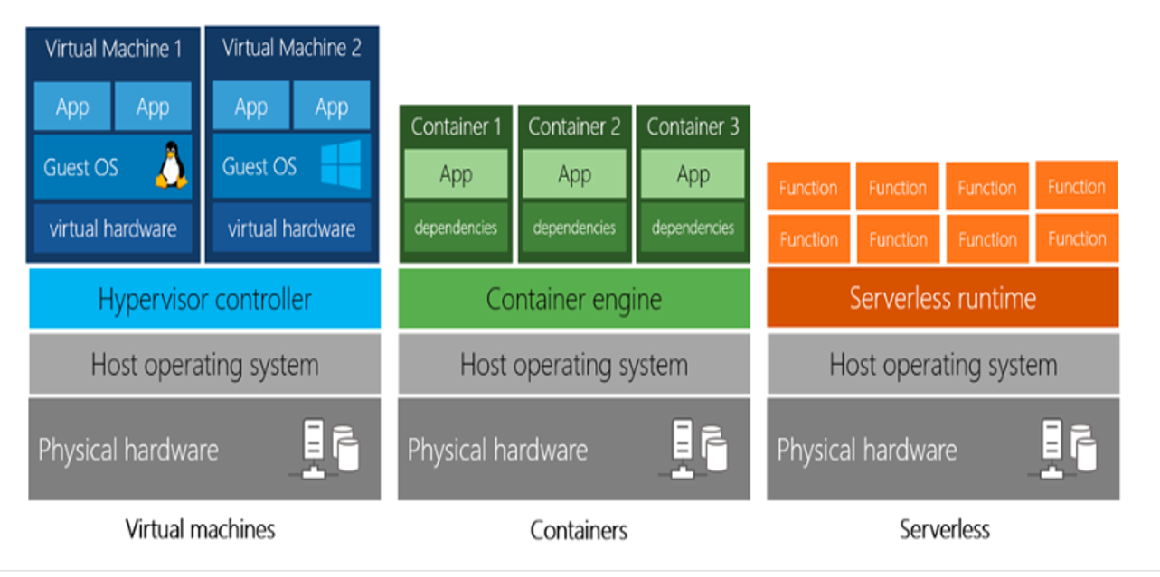
Virtual machines vs containers VS serverless

Slide 38
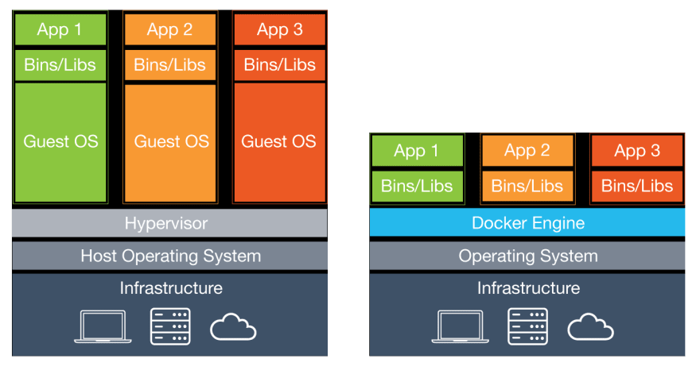
Virtual machines vs containers

Slide 39
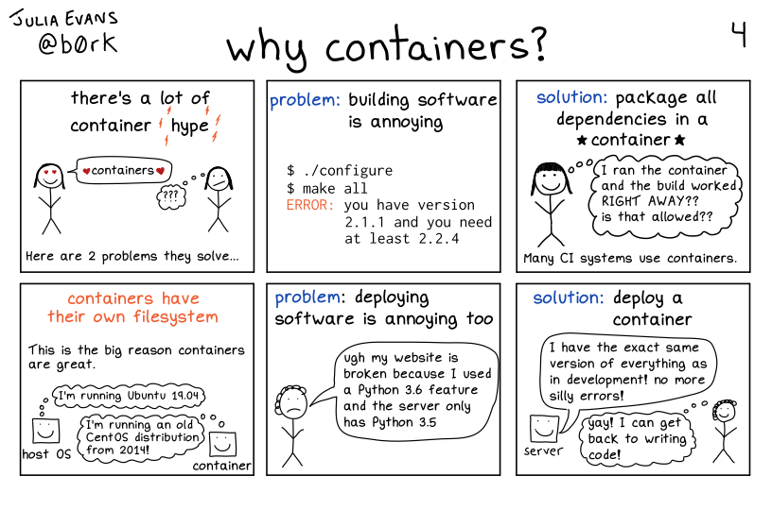

Slide 40
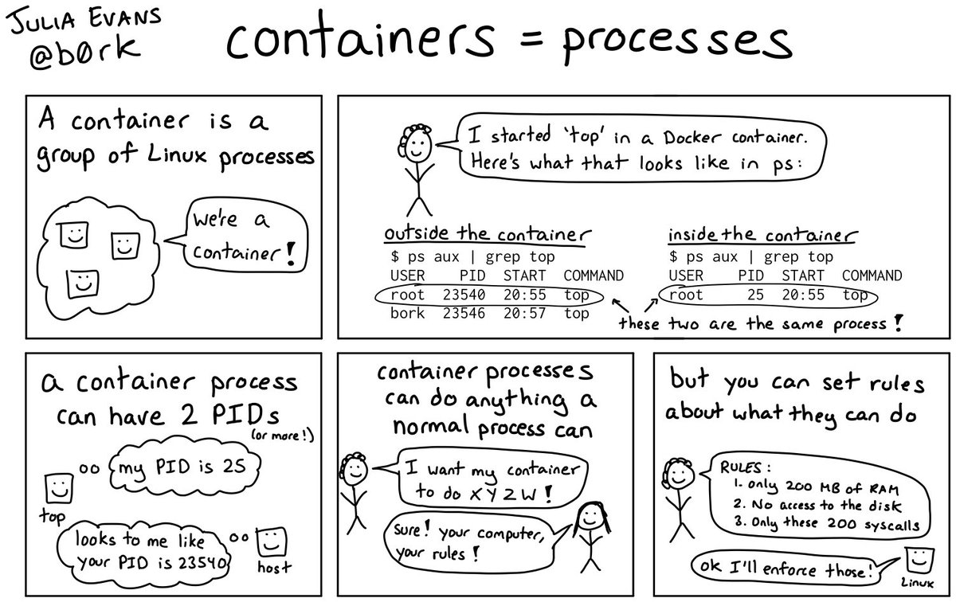

Slide 41
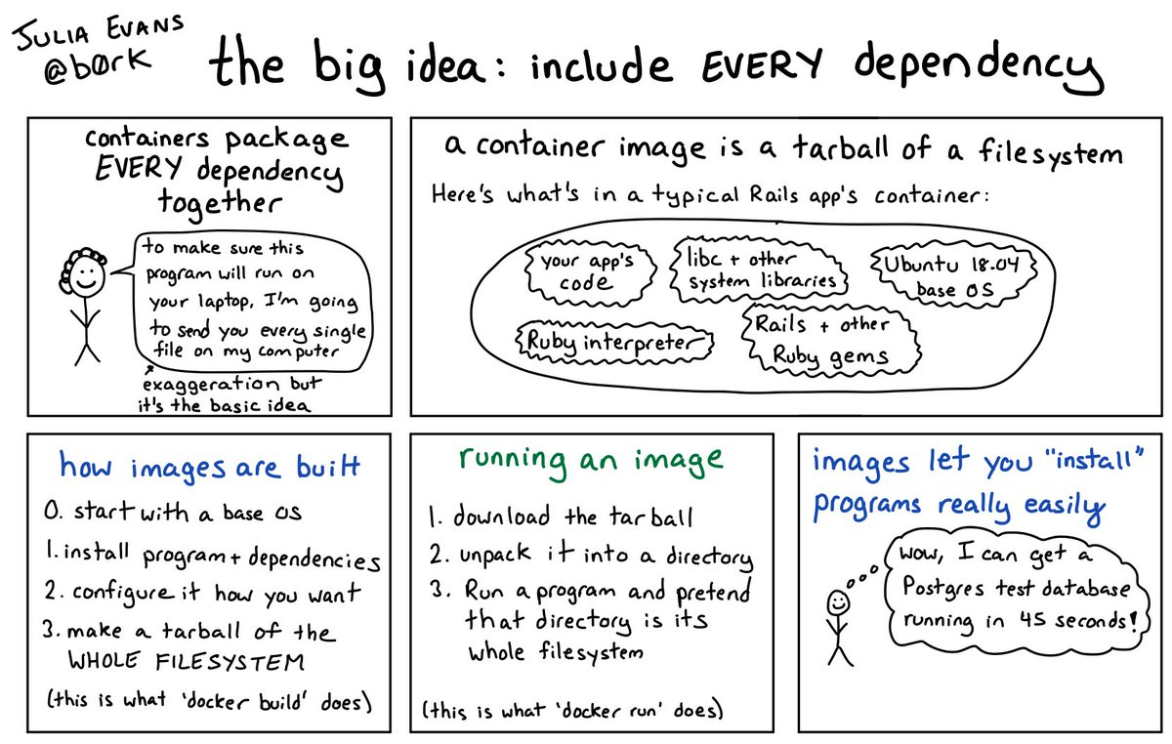

Slide 42
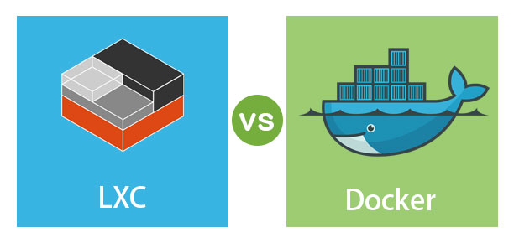

Slide 43
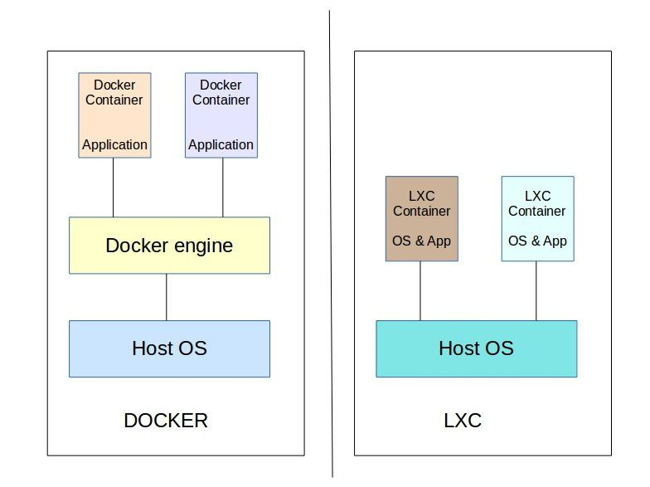
Linux containers (Lxc)
LXC is a user space interface for the Linux kernel containment features. Through a powerful API(LXD) and simple tools, it lets Linux users easily create and manage system or application containers. LXC containers are often considered as something in the middle between a chroot and a full fledged virtual machine. The goal of LXC is to create an environment as close as possible to a standard Linux installation but without the need for a separate kernel. Reference: https://linuxcontainers.org/lxc/introduction/

Slide 44

Containers uses the same host machine’s kernel instead of using a separate kernel but they have separate file systems.

Slide 45


Slide 46


Slide 47


Slide 48


Slide 49
Virtual Machines - Heavy
- Fixed memory, and CPU cores for each GuestOS (Non-sharable). LXC using LXD REST API Interface
- Lightweight than VMs.
- Uses LXD API to make LXC containers. - Each GuestOS can use entire hardware resources together (Memory, and CPU cores).
- We can also limit memory, and CPU core just like VMs.
- Nested LXC containers are possible.
- Each GuestOS uses the same host OS Kernel.
- LXC containers are used for running multiple applications in an isolated environment.
- More Fast than VMs. - How to make an LXC? https://www.youtube.com/watch?v=CWmkSj_B-wo - More on LXC, https://www.upguard.com/blog/docker-vs-lxc Application Containers
- More lightweight than LXC.
- Uses same host machine kernel.
- Docker containers(Application containers) are made for running single application per container.
- No need to worry about RAM, Space, CPU and other resource allocations for contaienrs.
- Fast than LXC.

Slide 50


Slide 52


docker
Docker is a set of platform as a service products that use OS-level virtualization to deliver software in packages called containers. Containers are isolated from one another and bundle their own software, libraries and configuration files; they can communicate with each other through well-defined channels. – Wikipedia.

Slide 53


Slide 54
Working of Docker
docker → docker daemon → containerd → runC → unshare syscall

Slide 55


Slide 56


Slide 57


Slide 58


Slide 59


Slide 108

← Shows status of docker engine.

Slide 109

← Shows status of docker engine.

Slide 110

← Gives information about containers, version, driver, filesystem etc.

Slide 111

← Lists total images available at host machine.

Slide 112

← Removes all the “exited/stopped” containers.

Slide 113


← Removes all the images.

Slide 114

← Stops the running container.

Slide 115

← Removes container having any id/name __.

Slide 116


Slide 117



Slide 118


Slide 119



Slide 120


Slide 121


Slide 122


Slide 123


Slide 124


Slide 125

It is not an IP address of Host Machine.

Slide 126

To check host machine’s IP address.

Slide 127

host machine’s IP address.

Slide 128


Slide 129

First_webserver container’s IP address.

Slide 130


Slide 131

Second_webserver container’s IP address.

Slide 132


Slide 133

Host’s port 80 was not mapped with first_webserver container.

Slide 134

Host’s port 100 was mapped with second_webserver container.

Slide 135

To attach your terminal's standard input, output, and error (or any combination of the three) to a running container using the container's ID or name. This allows you to view its ongoing output or to control it interactively, as though the commands were running directly in your terminal.

Slide 136


Slide 137


Slide 138


Slide 139


Slide 140


Slide 141
Image creation

Slide 142


Slide 143


Slide 144


Slide 145
VOLUME MAPPING

Slide 146
To make the container's memory persistent, we do volume mapping.
- If the container is restarted/deleted to upgrade versions of the current application, the memory will not be lost.
- Each container makes a new volume when it is created, these newly created volumes that are created at the time of the container's creation can be seen inside the host machine’s → 'var/lib/docker/volumes' directory. These volumes have a random 40 digit hashed name if the name is not given to the volume at the time of container creation.

Slide 147


Slide 148


Slide 149


Slide 150


Slide 151

Creating containers from already existing volumes.

Slide 152


Slide 153

Removing all the useless volumes that are not associated with any container (prune).

Slide 154

file/folder volume mapping.

Slide 155


Slide 156


Slide 157

All the changes are reflected inside container immediately.

Slide 158


Slide 159
MULTI-STAGE BUILDS

Slide 160


Slide 161


Slide 162


Slide 163


Slide 164

During multi-stage builds, docker creates and destroy the containers.

Slide 165

final and untagged images of multi-stage builds
huge difference in sizes.

Slide 166

“final output”

Slide 167
Docker Networking

Slide 168


Slide 169


Slide 170


Slide 171


Slide 172


Slide 173


Slide 174


Slide 175


Slide 176


Slide 177


Slide 178


Slide 179


Slide 180


Slide 181


Slide 182
No Name Resolution With Default Bridge Network (Docker0)

Slide 183


Slide 184


Slide 185


Slide 186


Slide 187


Slide 188


Slide 189
Name Resolution With User Defined Network

Slide 190


Slide 191


Slide 192


Slide 193


Slide 194


Slide 195


Slide 196


Slide 197


Slide 198


Slide 199


Slide 200


Slide 201


